Slide 1

OS Lab 5- Shell Scripting
Instructor
Aliza Saeed
aliza.saeed@nu.edu.pk

Slide 2
Arrays
An array is a systematic arrangement of the same type of data.
In Shell script Array is a variable
which contains multiple values may be of same type
or different type
An array is zero-based i.e. indexing start with 0.

Slide 3
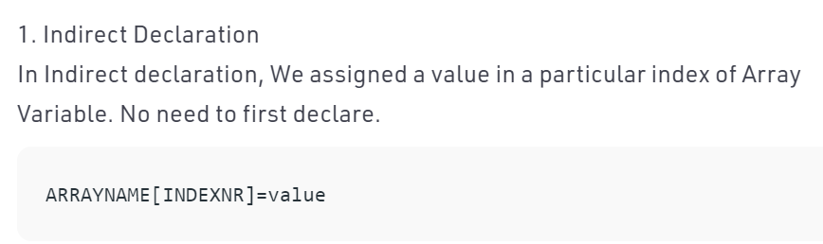
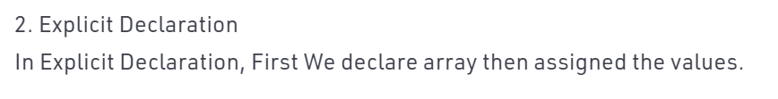
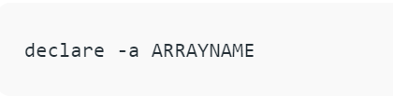
Declaring an array

Slide 4
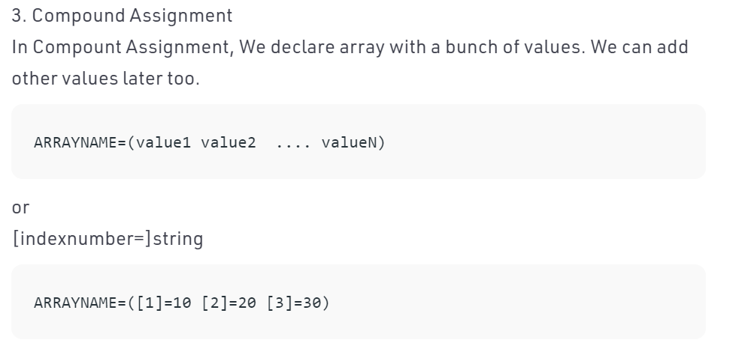
Declaring an array

Slide 5
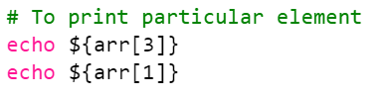
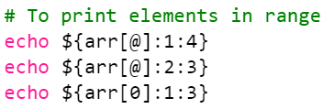
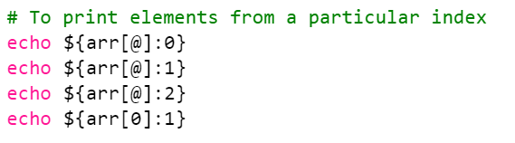
Printing the value of arrays

Slide 6
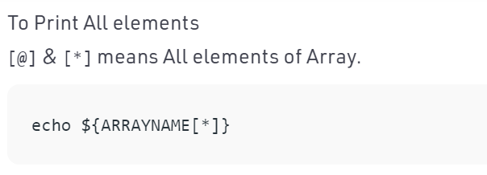
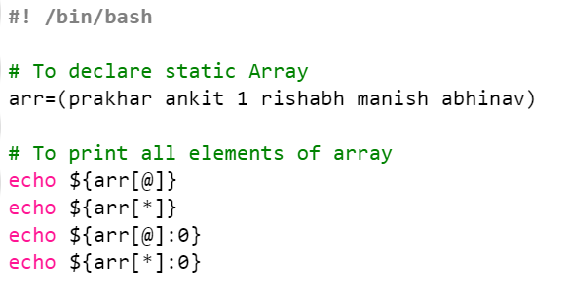

Printing the value of arrays

Slide 7
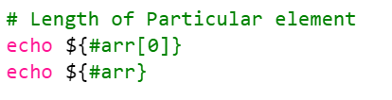
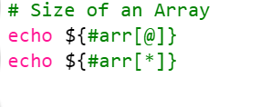
Counting length of array elements

Slide 8
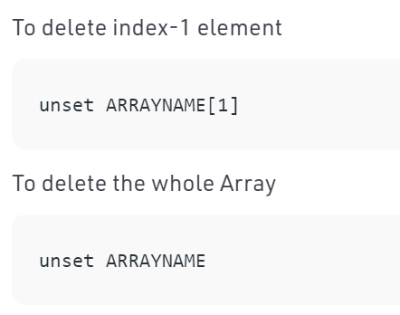
Deletion

Slide 9
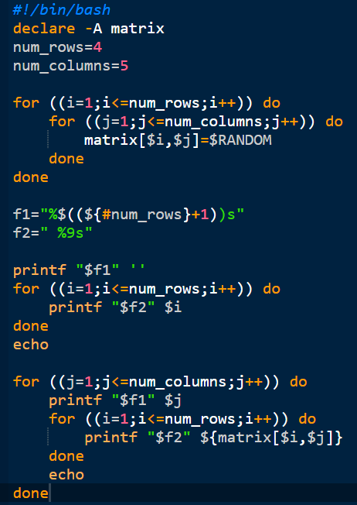
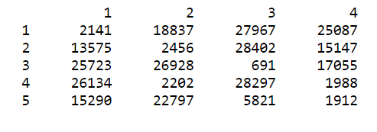
2D arrays

Slide 10
Managing strings
#!/bin/bash
# Basic for loop
declare -a names=("Stan kil" "Kyle" "Cartman")
for name in "${names[@]}"
do
echo $name
done
echo All done

